Slide 1
Algorithm Analysis

Slide 2
Analysis and Design of algorithms

Slide 3
Books
Fundamentals of Computer algorithms Horowitz, Sahani and Rajasekaran
Introduction to Algorithms
Coremen, Leiserson
The Design and Analysis of Computer Algorithms
Aho, Hopcroft and Ullman

Slide 4
ALGORITHM
A finite set of instructions which if followed accomplish a particular task.
In addition every algorithm must satisfy following criteria:

Slide 5
Input: zero or more quantities externally supplied
Output: at least one quantity is produced
3. Definiteness: Each instruction must be clear and unambiguous.
4. Finiteness: In all cases algorithm must terminate after finite number of steps.
5. Effectiveness: each instruction must be sufficiently basic.

Slide 6
Two algorithms on two systems
Algorithm A₁ 50 n lg n
Algorithm A₂ 2 n²
A₂
Super computer
10⁸ ins/sec
A₁
P.C
10⁶ ins /sec

Slide 7
For n = 10⁶
Time taken by Super Computer
= 2.(10⁶)²/ 10⁸ = 20,000 sec
Time taken by P .C.
= 50 . 10⁶ lg 10⁶ / 10⁶ = 1,000 sec

Slide 8
Thus by using a fast algorithm , the personal computer gives results
20 times faster than the result given by super computer using a slow algorithm.
Thus a good algorithm is like a sharp knife, it does exactly what it is supposed to do
with a minimum amount of effort.

Slide 9
Complexity
Some questions to answer:
How fast can we solve a problem?
There may be many algorithms for a
given problem. Which algorithm to use?
What are the classical algorithm
design techniques ?
Are there problems inherently difficult
to solve?

Slide 10
How do we express the complexity of algorithm?
Resources : Time and Space
Complexity lower bounds for problems.
Complexity classes P, NP etc.

Slide 11
Pseudocode
Pseudocode is an English language like representation of the code required for an algorithm.
It is partly English, partly structured code.
The English part provides a relaxed syntax that is easy to read.
The code part consists of an extended version of the basic algorithmic constructs-sequence, selection and iteration.

Slide 12
Sequence, selection, loop
A sequence is a series of statements that do not alter the execution path within an algorithm.
Statements such as assign and add are sequence statements.
A call to another algorithm is also considered a sequence statement.
Selection statements evaluate one or more alternatives. Paths are followed based on its result.

Slide 13
The typical selection statement is the two way selection
if (condition) action 1 else action 2.
The part of the loop are identified by indentation.
Loop iterates a block of code. It closely resembles the while loop. It is a pretest loop.

Slide 14
Example
Algorithm deviation
It finds deviations from average.
Pre: nothing
Post: numbers are read and deviation from average printed

Slide 15
i= 0
Loop(all data are read)
1 I = I + 1
2 read numbers into array[i]
3 sum = sum + number
Average = sum / I
Print (average)
J = 0
Loop (j < i)
1 j = j+ 1
2 dev = array[j] – average
3 print (array [ j] . Dev)
Return
End deviation

Slide 16
Asymptotic notations( O , Ω , Θ )

Slide 17
Analysis vs. Design
Analysis: predict the cost of an algorithm in terms of resources and performance
Design: design algorithms which minimize the cost

Slide 18
Time Complexity
Real Time:
To analyze the real time complexity of a program we need to determine two numbers for each statement in it:
amount of time a single statement will take.
No. of times it is executed.
Product of these two, will be the total time taken by the statement.

Slide 19
First no. depends upon the machine and compiler used , hence the real time complexity is machine dependent.

Slide 20
Machine model: Generic Random Access Machine (RAM)
Executes operations sequentially
Set of primitive operations:
  Arithmetic. Logical, Comparisons, Function calls
Simplifying assumption: all ops cost 1 unit
  Eliminates dependence on the speed of our computer, otherwise impossible to verify and to compare

Slide 21
Frequency count
To make analysis machine independent
it is assumed that every instruction takes the same constant amount of time for execution.
Hence the determination of time complexity of a program is the matter of summing the frequency counts of all the statements.

Slide 22
Linear loop
i=1
Loop(I <= 1000)
  1 application code
  2 I = I + 1
  The body of the loop is repeated 1000 times.
  I = 1
  Loop (I <= n)
    Application code
    I = I + 2
    For this the code time is proportional to n

Slide 23
Logarithm Loops
  Multiply loops Divide loops
  I = 1 1 I = n
  Loop (I < n) 2 loop( i>= 1)
    1 application code 1 application code 2 I=I/2
    2 I = i*2
  F(n) = [log n] F(n) = [log n]

Slide 24
Nested loop- linear logarithmic
1 I = 1
2 loop(I <= n)
  1 j = 1
  2 loop( j < = n)
  1 application code
  2 j = j *2
  3 I = I + 1
  F(n ) = [n log n]

Slide 25
Dependent Quadratic
1 I = 1
2 loop ( I < = n)
1 j = 1
2 loop( j < = i)
1 application code
2 j = j + 1
3 I = I + 1
no of iterations in the body of the inner loop is
1 + 2 + 3 + 4 +… + n I.e. n(n +1)/2
On an average = ( n+1/)2
thus total no of iterations = n (n+1)/2

Slide 26
Quadratic
i=1
Loop (I < = n)
  j = 1
  Loop( j < = n)
  1 application code
  2 j = j+1
  I = i+1
  F(n) = n²

Slide 27
Insertion sort
INSERTION-SORT (A, n) ⊳ A[1 . . n]
for j ← 2 to n
do key ← A[j]
i ← j – 1
while i > 0 and A[i] > key
do A[i+1] ← A[i]
i ← i – 1
A[i+1] ← key
“pseudocode”
1
j
i
n
A:
key
sorted

Slide 28
Insertion Sort
// At start, the singleton sequence A[1] is trivially sorted Freq.
1 for j ← 2 to length[A] n
2 do key ← A[j] n-1
* insert A[j] into sorted array * sequence A[1….j-1]
I ← j-1 n-1
// let tj be the number of times the following
//while-loop is tested for the value j
4 while I> 0 and A[I] > key ∑t_{j}
Do A[I+1] ← A[I] ∑(t_{j}-1)
6 I ← I-1 ∑(t_{j}–1)
7 A[I+1] ← key n-1

Slide 29
T(n) =
c₁ n + c₂ (n-1) + c3(n-1)+ c₄ ∑t_{j} +
c₅ ∑(t_{j}-1) + c₆ ∑(t_{j}-1) +
c₇ (n-1)

Slide 30
If C_{j} = 1
T(n) = n + (n-1) + (n-1) + Σt_{j} + 2 Σ(t_{j}-1) + (n-1)
= n + 3(n-1) + 3Σt_{j} -2(n-1)
T(n) = 2n + 3 Σ (t_{j} ) for j = 1 to n-1
= O( n² )

Slide 31
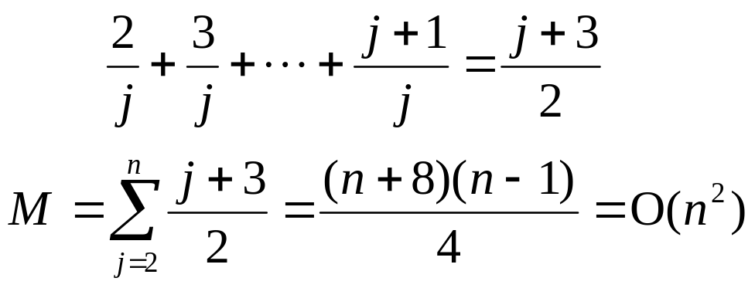
average case:
x_{j} is being inserted into the sorted sequence
x₁ x₂ ... x _{j-1}
the probability that x_{j} is the largest: 1/j
  takes 2 data movements
the probability that x_{j} is the second largest : 1/j
  takes 3 data movements
:
# of movements for inserting x_{j}:
1 4 7 5

Slide 32
Worst Case and best case
Best case: file is already sorted
in this case t_{j} = 1
so total time is a linear function of n
Worst case: if file is in the reverse order
in this case t_{j} = j-1
so total time is a quadratic function of n

Slide 33
Binary search
sorted sequence : (search 9)
1 4 5 7 9 10 12 15
step 1 ↑
step 2 ↑
step 3 ↑
best case: 1 step = O(1)
worst case: (⎣log₂ n⎦+1) steps = O(log n)
average case: O(log n) steps

Slide 34
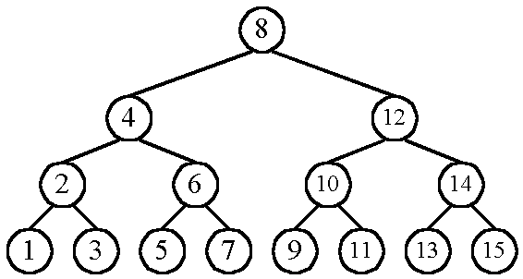
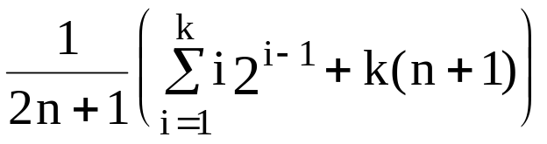
    n cases for successful search
    n+1 cases for unsuccessful search
    Average # of comparisons done in the binary tree:
    A(n) = , where k = ⎣log n⎦+1

Slide 35
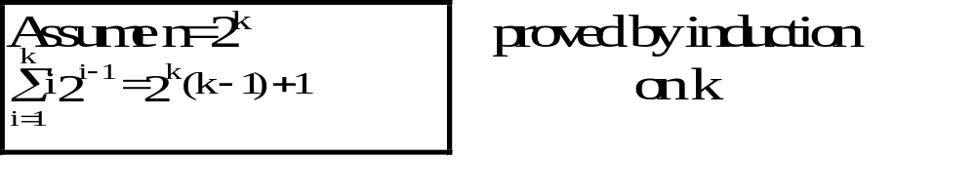
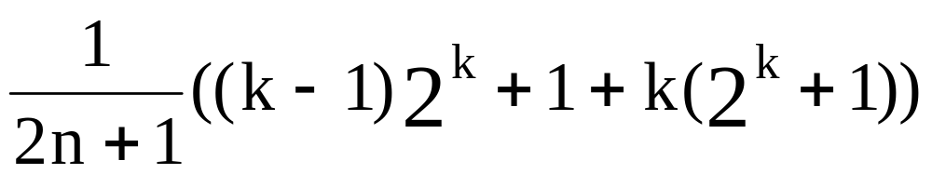
      A(n) =
      ≈ k as n is very large
      = log n
      = O(log n)

Slide 36
Straight selection sort
7 5 1 4 3
1 5 7 4 3
1 3 7 4 5
1 3 4 7 5
1 3 4 5 7
Only consider # of changes in the flag which is used for selecting the smallest number in each iteration.
  best case: O(1)
  worst case: O(n²)
  average case: O(n log n)

Slide 37
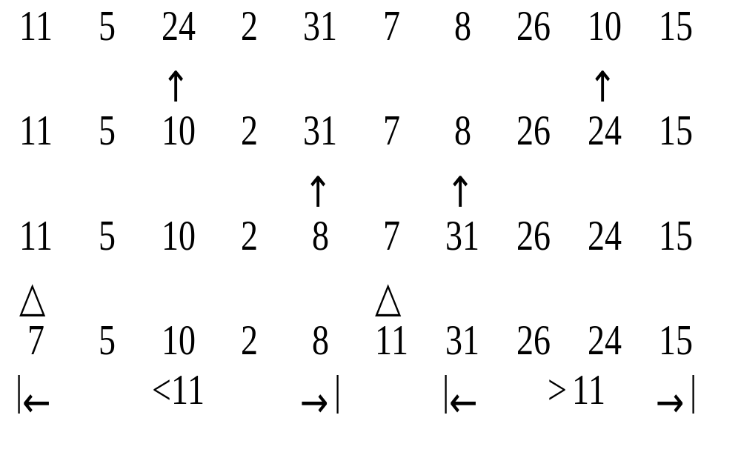
Quick sort
Recursively apply the same procedure.

Slide 38
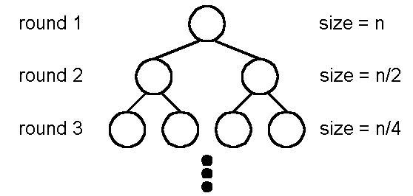
Best case : O(n log n)
  A list is split into two sublists with almost equal size.
log n rounds are needed.
In each round, n comparisons (ignoring the element used to split) are required.

Slide 39
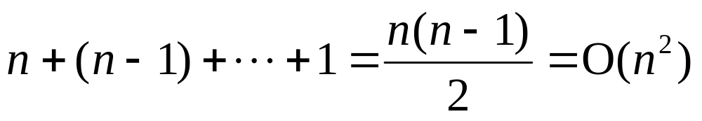
Worst case : O(n²)
In each round, the number used to split is either the smallest or the largest.

Slide 40
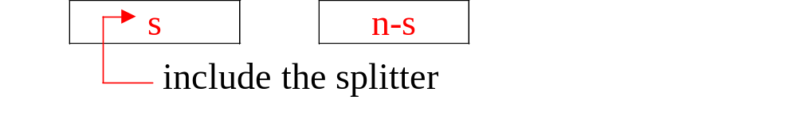

Average case: O(n log n)

Slide 41
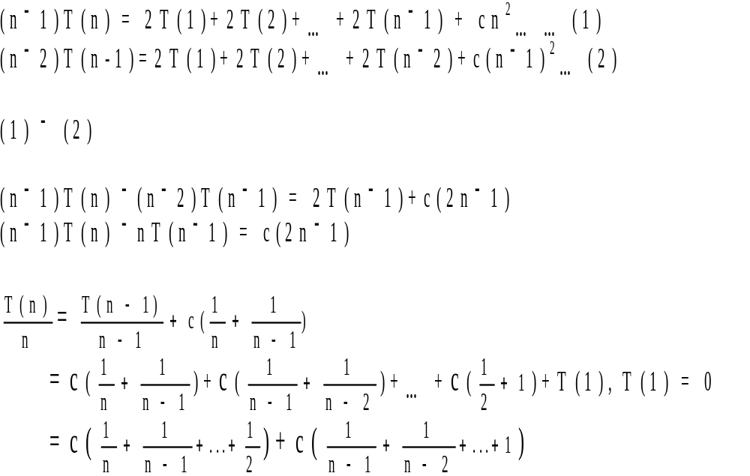

Slide 42
<= 2log(n)+ constant
Thus
T(n) <= n log(n)

Slide 43
Example of insertion sort
8
2
4
9
3
6
2
8
4
9
3
6
2
4
8
9
3
6
2
4
8
9
3
6
2
3
4
8
9
6
2
3
4
6
8
9
done

Slide 44
Worst/ best/average cases
Worst case is the longest running time for any input of size n
O-notation represents upper bound I.e. an upper bound for worst case.
Best case is time taken for some input data set that results in best possible performance.You cannot do better. This is lower bound.
Average case is the average performance

Slide 45
Asymptotic Notation
Goal: to simplify analysis by getting rid of unneeded information (like “rounding” 1,000,001≈1,000,000)
We want to say in a formal way 3n² ≈ n²

Slide 46
The “Big-Oh” Notation:
given functions f(n) and g(n), we say that f(n) is O(g(n) ) if and only if there are positive constants c and n₀ such that f(n)≤ c g(n) for
  n ≥ n₀

Slide 47
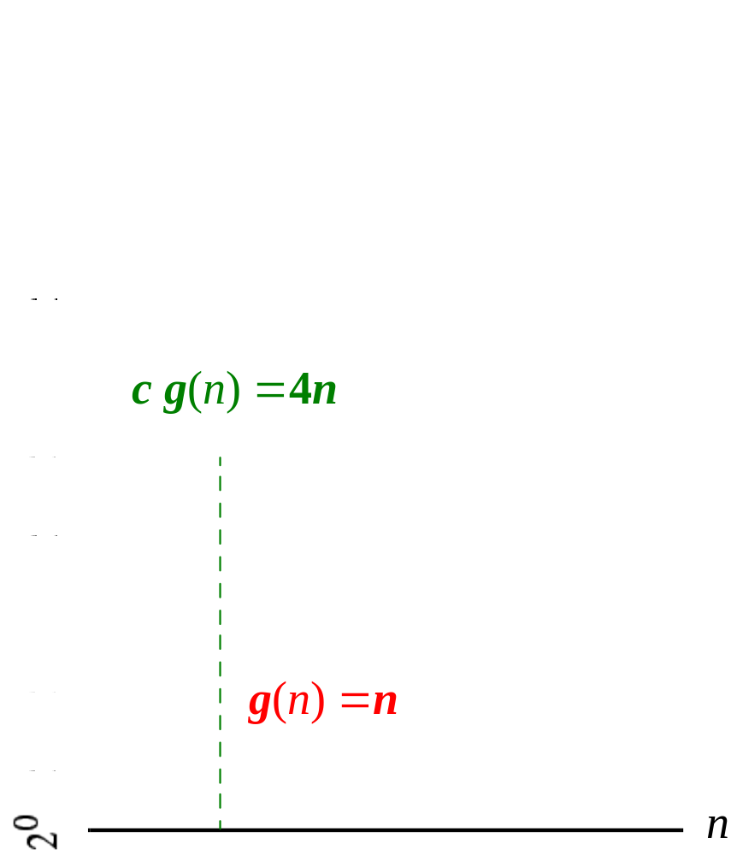

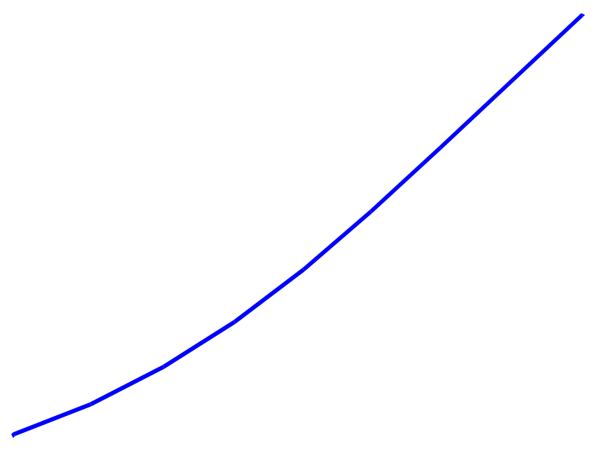
Example
For functions f(n) and g(n) (to the right) there are positive constants c and n₀ such that:
f(n) ≤ c g(n)
for n ≥ n₀
conclusion:
2n+6 is O(n).

Slide 48
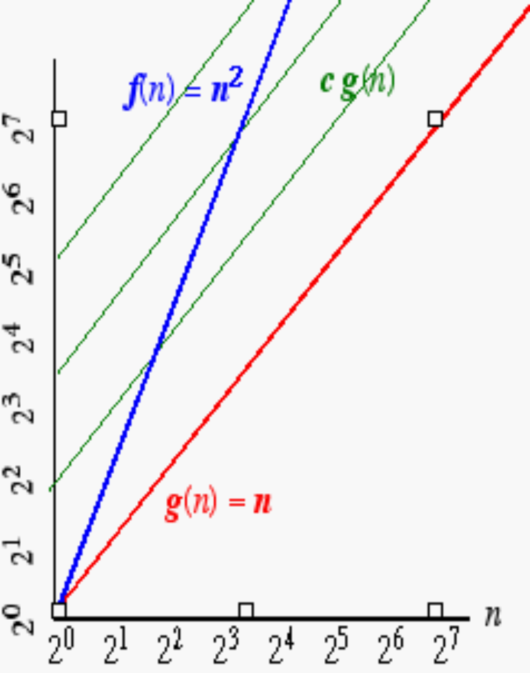
Another Example
On the other hand…
n² is not O(n) because there is no c and n₀ such that: n² ≤ c n for n ≥ n₀
(As the graph to the right illustrates, no matter how large a c is chosen there is an n big enough that
N² > c n ) .

Slide 49
Asymptotic Notation (cont.)
Note: Even though it is correct to say “7n - 3 is O(n³)”, a better statement is “7n - 3 is O(n)”, that is, one should make the approximation as tight as possible
Simple Rule: Drop lower order terms and constant factors
  7n-3 is O(n)
  8n²log n + 5n² + n is O(n²log n)

Slide 50
Asymptotic Notation (terminology)
Special classes of algorithms:
constant O(1)
  logarithmic: O(log n)
  linear: O(n)
  quadratic: O(n²)
  polynomial: O(n^{k}), k ≥ 1
  exponential: O(a^{n}), a > 1

Slide 51
EXAMPLE
Consider 1/3 n² – 5n
The dominating term is n²
Therefore it should be of O(n²)
Given a positive constant c , a positive integer n₀ to be found such that
1/3 n² - 5 n ≤ c n²

Slide 52
Dividing the inequality throughout by n²
1/3 - 5/n ≤ c
Therefore if n₀ ≥ 1 , choosing c ≥ 1/3 the inequality will never be violated
Hence the expression is indeed of O(n²)

Slide 53
Polynomial of degree k is O( n^{k})
T(n) = a_{k} n^{k} + a_{k-1} n^{k-1} +……..a₀ is O( n^{k})
T(n) <= |a_{k}| n^{k} +| a_{k-1}| n^{k-1} +…….|a₀|
<= n^{k}(|a_{k}| n⁰ +| a_{k-1}| n⁻¹ +…….|a₀|n^{-k})
<= n^{k}(|a_{k}| n⁰ +| a_{k-1}| n⁻¹ +…….|a₀|n^{-k}) for n >1
Since n >1 n ^{I-k} <1 for I 0 <= I <= k
Therefore
T(n) <= n^{k} ( |a₀| + |a₁ | + …. |a_{k} |)
let c = ( |a₀| + |a₁ | + …. |a_{k} |)
And f(n) = n^{k}
T(n) <= c f(n) for n >1
Thus T(n) = O( n^{k})

Slide 54
“Relatives” of the Big-Oh
Ω (f(n)): Big Omega--asymptotic lower bound
  Θ (f(n)): Big Theta--asymptotic tight bound

Slide 55
Asymptotic Analysis of The Running Time
Use the Big-Oh notation to express the number of primitive operations executed as a function of the input size.
Comparing the asymptotic running time
  -an algorithm that runs in O(n) time is better than one that runs in O(n²) time
  -similarly, O(log n) is better than O(n)
  -hierarchy of functions: log n << n << n² << n³ << 2^{n}

Slide 56
Caution! Beware of very large constant factors.
An algorithm running in time 1,000,000 n is still
O(n) but might be less efficient on your data set
than one running in time 2n², which is O(n²)

Slide 57
Properties of the O notation
Constant factors may be ignored
  ∀ k > 0, kf is O( f)

Slide 58
Properties of the O notation
Constant factors may be ignored
  ∀ k > 0, kf is O( f)
Higher powers grow faster
  n^{r} is O( n^{s}) if 0 ≤ r ≤ s

Slide 59
Properties of the O notation
Constant factors may be ignored
  ∀ k > 0, kf is O( f)
Higher powers grow faster
  n^{r} is O( n^{s}) if 0 ≤ r ≤ s
Fastest growing term dominates a sum
  If f is O(g), then f + g is O(g)
  eg an⁴ + bn³ is O(n⁴ )

Slide 60
Properties of the O notation
Constant factors may be ignored
  ∀ k > 0, kf is O( f)
Higher powers grow faster
  n^{r} is O( n^{s}) if 0 ≤ r ≤ s
. Fastest growing term dominates a sum
  If f is O(g), then f + g is O(g)
  eg an⁴ + bn³ is O(n⁴ )
. Polynomial’s growth rate is determined by leading term
  If f is a polynomial of degree d,
  then f is O(n^{d})

Slide 61
Properties of the O notation
f is O(g) is transitive
  If f is O(g) and g is O(h) then f is O(h)

Slide 62
Properties of the O notation
Product of upper bounds is upper bound for the product
  If f is O(g) and h is O(r) then fh is O(gr)

Slide 63
Properties of the O notation
f is O(g) is transitive
  If f is O(g) and g is O(h) then f is O(h)
Product of upper bounds is upper bound for the product
  If f is O(g) and h is O(r) then fh is O(gr)
Exponential functions grow faster than powers
  n^{k} is O( b^{n} ) ∀ b > 1 and k ≥ 0
  eg n²⁰ is O( 1.05^{n})

Slide 64
Properties of the O notation
f is O(g) is transitive
  If f is O(g) and g is O(h) then f is O(h)
Product of upper bounds is upper bound for the product
  If f is O(g) and h is O(r) then fh is O(gr)
Exponential functions grow faster than powers
  n^{k} is O( b^{n} ) ∀ b > 1 and k ≥ 0
  eg n²⁰ is O( 1.05^{n})
Logarithms grow more slowly than powers
  log_{b}n is O( n^{k}) ∀ b > 1 and k > 0
  eg log₂n is O( n^{0.5})
  Thus {log₂(n)}² is O(n^{k}) for any k > 0

Slide 65
Properties of the O notation
f is O(g) is transitive
  If f is O(g) and g is O(h) then f is O(h)
Product of upper bounds is upper bound for the product
  If f is O(g) and h is O(r) then fh is O(gr)
Exponential functions grow faster than powers
  n^{k} is O( b^{n} ) ∀ b > 1 and k ≥ 0
  eg n²⁰ is O( 1.05^{n})
Logarithms grow more slowly than powers
  log_{b}n is O( n^{k}) ∀ b > 1 and k > 0
  eg log₂n is O( n^{0.5})
Important!

Slide 66
Properties of the O notation
All logarithms grow at the same rate
  log_{b}n is O(log_{d}n) ∀ b, d > 1

Slide 67
Properties of the O notation
All logarithms grow at the same rate
  log_{b}n is O(log_{d}n) ∀ b, d > 1
Sum of first n r^{th} powers grows as the (r+1)^{th} power
  Σ k^{r} is Θ ( n^{r+1} )
  eg Σ i = is Θ ( n² )
n
k=1
n
n(n+1)
k=1
2

Slide 68
Polynomial and Intractable Algorithms
Polynomial Time complexity
  An algorithm is said to be polynomial if it is
  O( n^{d} ) for some integer d
  Polynomial algorithms are said to be efficient
    They solve problems in reasonable times!
Intractable algorithms
  Algorithms for which there is no known polynomial time algorithm
  We will come back to this important class later in the course

Slide 69
Categories of algorithm efficiency
Efficiency Constant | Big O O(1)
Logarithmic | O(log n)
Linear | O(n)
Linear logarithmic | O(n log n)
Quadratic | O(n²)
Polynomial | O(n^{k})
Exponential | O(c^{n})
Factorial | O(n!)

Slide 70

Θ-notation
For function g(n), Θ(g(n)) is given by:
Θ(g(n)) = {f(n): ∃ +ve constants c₁, c₂, and n₀ such that 0 ≤ c₁g(n) ≤ f(n) ≤ c₂g(n),
∀n ≥ n₀ }
Intuitively: Set of all functions that
have the same rate of growth as g(n).
g(n) is an asymptotically tight bound for f(n).

Slide 71

O -notation
For function g(n), O(g(n)) is given by:
O(g(n)) = {f(n): ∃ +ve constants c and n₀ such that 0 ≤ f(n) ≤ cg(n), ∀n ≥ n₀ }
Intuitively: Set of all functions whose rate of growth is the same as or lower than that of g(n).
g(n) is an asymptotic upper bound for f(n).
f(n) = Θ(g(n)) ⇒ f(n) = O(g(n)).
Θ(g(n)) ⊂ O(g(n)).

Slide 72

Ω -notation
For function g(n), Ω(g(n)) is given by:
Ω(g(n)) = {f(n): ∃ +ve constants c and n₀ such that 0 ≤ cg(n) ≤ f(n), ∀n ≥ n₀ }
Intuitively: Set of all functions whose rate of growth is the same as or higher than that of g(n).
g(n) is an asymptotic lower bound for f(n).
f(n) = Θ(g(n)) ⇒ f(n) = Ω(g(n)).
Θ(g(n)) ⊂ Ω(g(n)).

Slide 73
Relations Between Θ, O, Ω

Slide 74
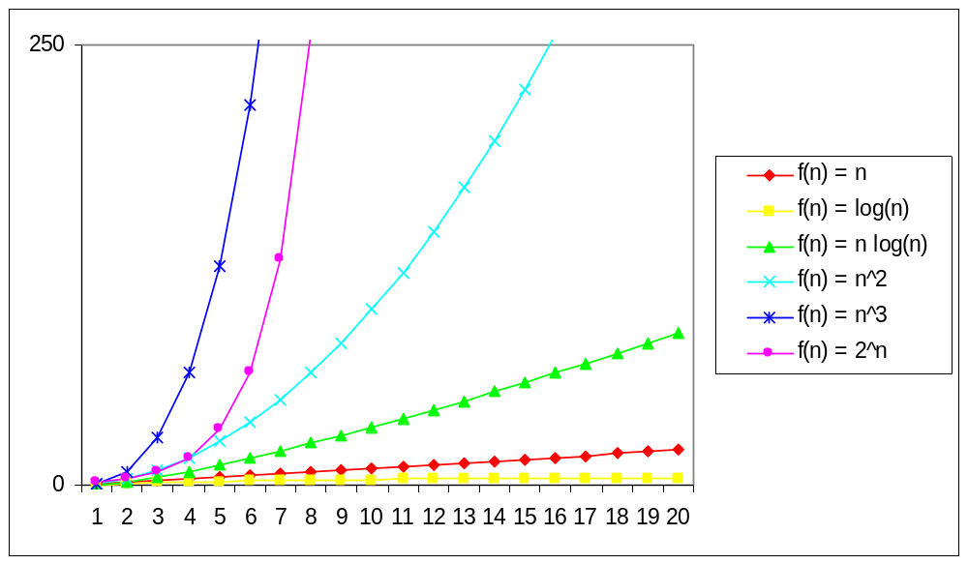
Practical Complexity

Slide 75
Problem size
 | 10 | 10² | 10³ | 10⁴
log₂n | 3.3 | 6.6 | 10 | 13.3
n | 10 | 10² | 10³ | 10⁴
nlog₂n | 0.33x10 | 0.7x10³ | 10⁴ | 1.3x10⁵
n² | 10² | 10⁴ | 10⁶ | 10⁸
2^{n} | 1024 | 1.3x10³ | >10¹⁰⁰ | >10¹⁰⁰
n! | 3x10⁶ | >10¹⁰⁰ | >10¹⁰⁰ | >10¹⁰⁰

Slide 76
Q1 Find functions f and g such that
(i) f is O (g)
(ii) f is not Θ (g)
(iii) f(n) > g(n) for infinitely many n.
Let us take g(n) = ½ for all n
f(n) be a function with values in(0,1) close to 1.
f(n) = sin(n) or
f(n) = 1/n if n is perfect square and 1 otherwise.

Slide 77
Exercise 1
If the complexity of the algorithm DOIT can be expressed as O(n²)
Calculate the complexity of the following program segment:
I = 1
loop ( I < n)
DOIT(…)
I = I* 2
Answer : O(n² log₂n)

Slide 78
Exercise
Reorder the following complexity from smallest to largest:
N log₂(n)
n + n² + n³
2⁴
√n
Answer :
(a) 2⁴
(b) √n
(c) N log₂(n)
(d) n + n² + n³

Slide 79
Find Two non negative functions f(n) and g(n) such that neither f(n) = O(g(n)) nor g(n) is O(f(n))
Let f(n) = 1+ cos (n)
g(n) = 1+ sin(n)
when f(n) = 0, g(n) = 2
And
when g(n) = 0 , f(n) = 2
it is not possible to find a positive constant c such that f(n) <= c g(n) for large n . Because g(n) always comes back to zero when f(n) is 2

Slide 80
Is 2^{n+1} = O(2^{n} )? Is 2 ^{2n} = O( 2 ^{n})?
Is 2^{n+1} = O(2^{n} )? Yes!
For any c >= 2
2^{n+1} <= C(2^{n} ) for all n >= 1
However
Is 2 ^{2n} = O( 2 ^{n})? Not correct.
Lim 2 ^{2n} / ( 2 ^{n} ) is not finite.

